Slide 1
The Walking Dead
Phoenix Team
Kriti Jar
Ruchika Hazariwal
Harsh Agarwal
Hemaprasanthi Mutyala

Slide 2
Introduction
Presenting you all interactive single player Greenfoot game as the final project for CMPE 202.
The walking Dead is a challenge game for a single played named Daryl, who needs to kill the zombies and cross the levels of game to win the game.
During the game, his score keeps increasing when he grabs food and gets immunity with a first aid kit.
If he collides with zombie, and doesn’t have immunity, he dies, and game is over.

Slide 3
Agile Methodology
Agile methodology was followed during the entire game development process.
We completed the game in 4 sprints of one week each.
It helped us to keep track of our designing and development iterative process and deliver the game on time with all requirements satisfied.

Slide 4
Sprint planning
Sprint 1: We decided game idea and designed the initial UML diagrams that included wireframe diagrams, System Sequence diagram, Activity diagram, Use case diagrams.
Sprint 2: Decided the class diagrams and sequence diagrams and designed initial game that included basic functionalities of all actors.
Sprint 3: Additional functionalities of changing level of game and making it more challenging and updated the designing as we progressed with development.
Sprint 4: Integrated testing and preparations for the final delivery.

Slide 5
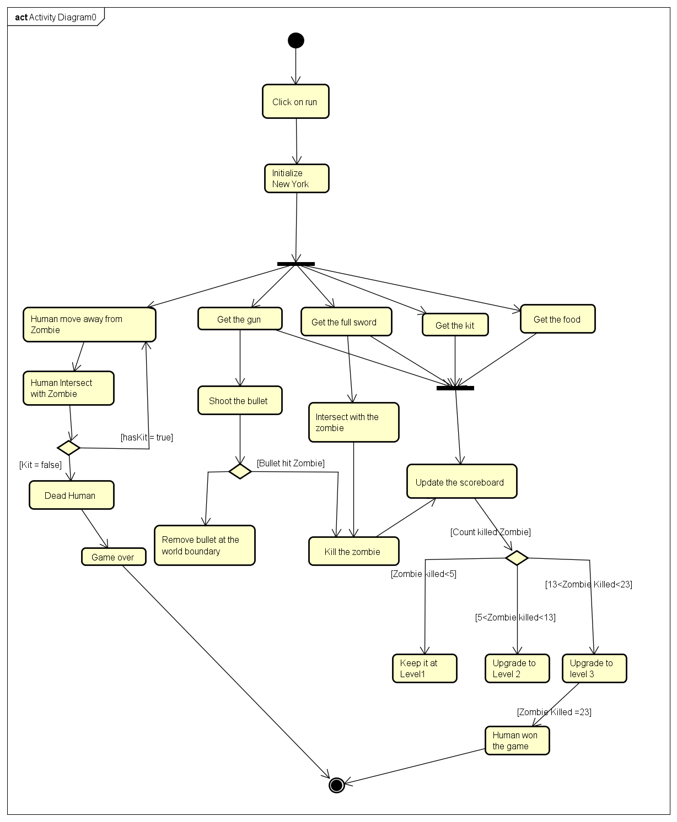
Activity Diagram

Slide 6
Sequence Diagram

Slide 7
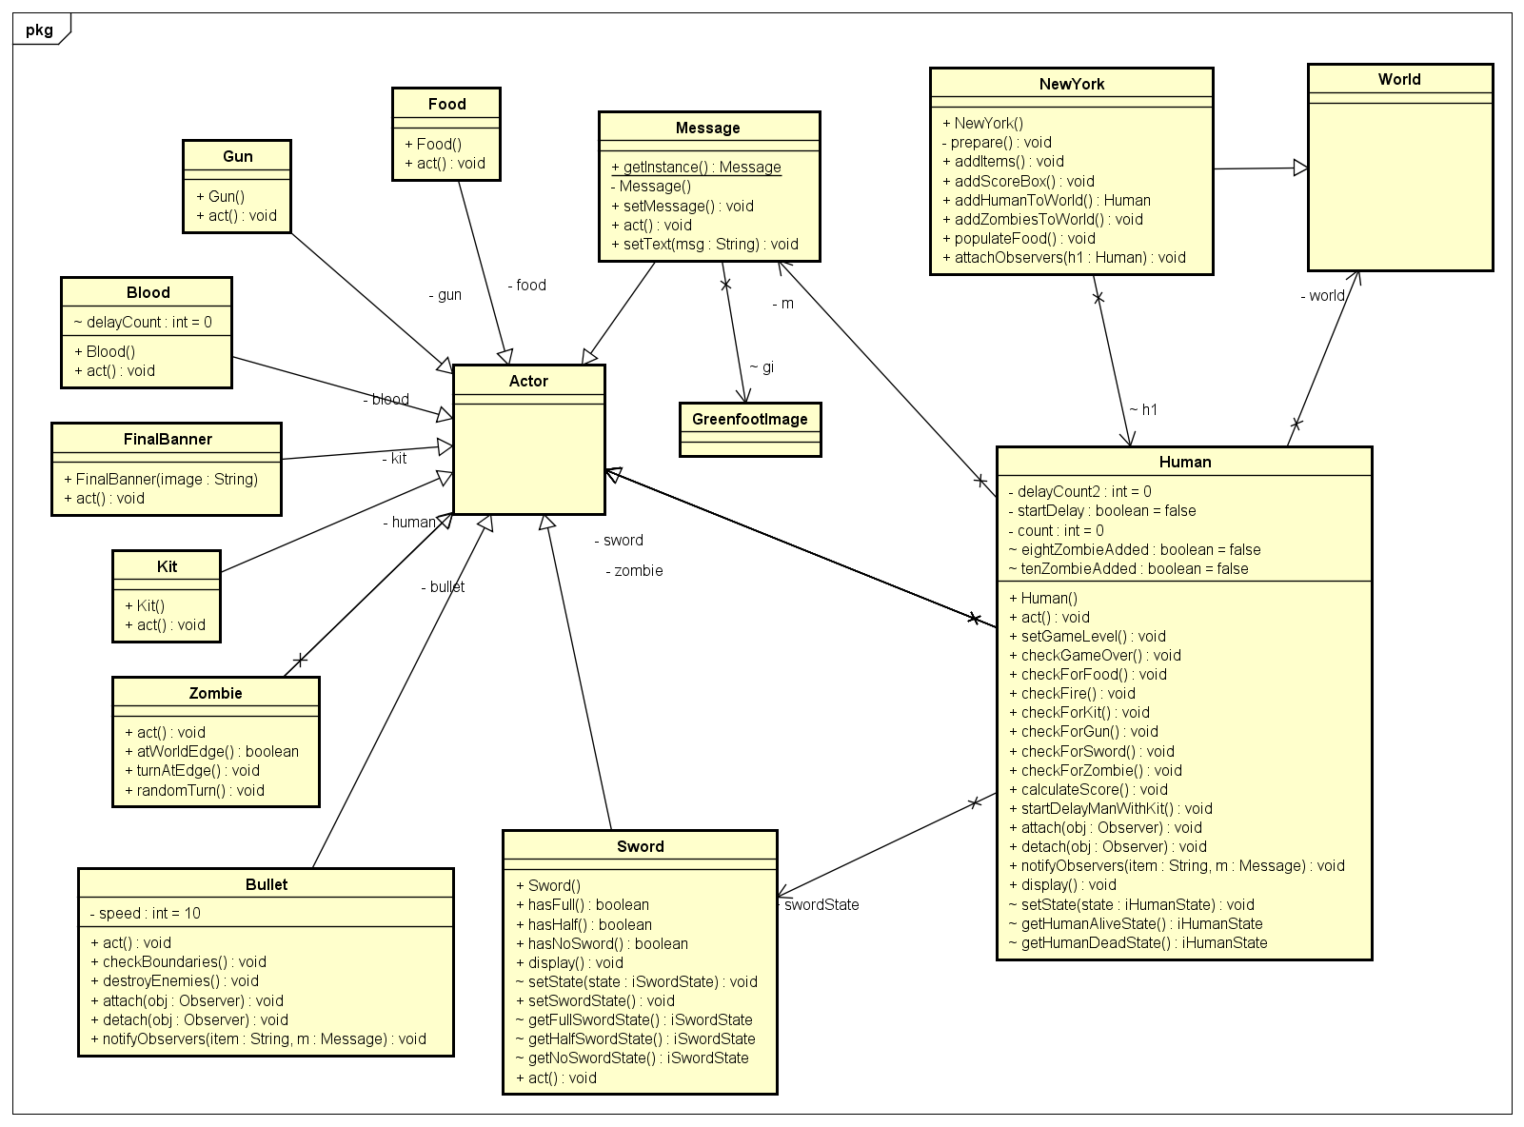
Actors and World class diagram

Slide 8
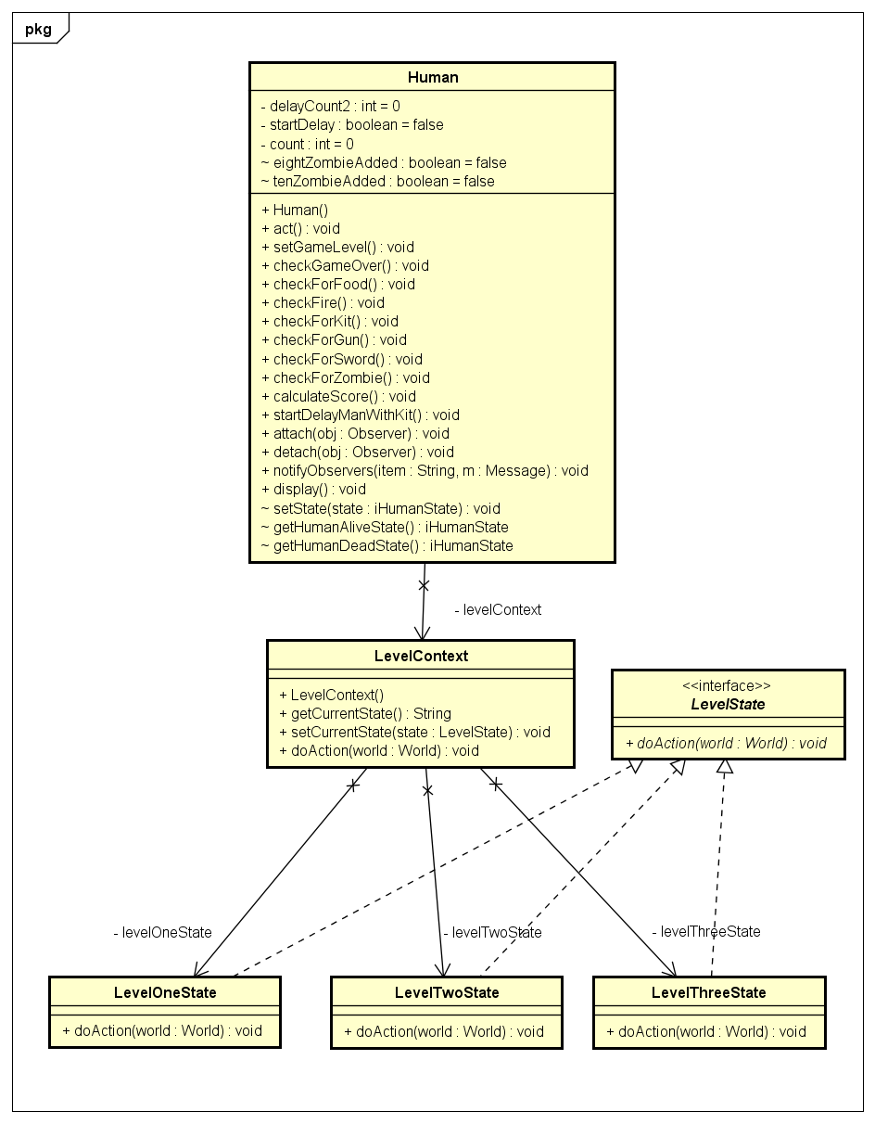
Level State Diagram

Slide 9
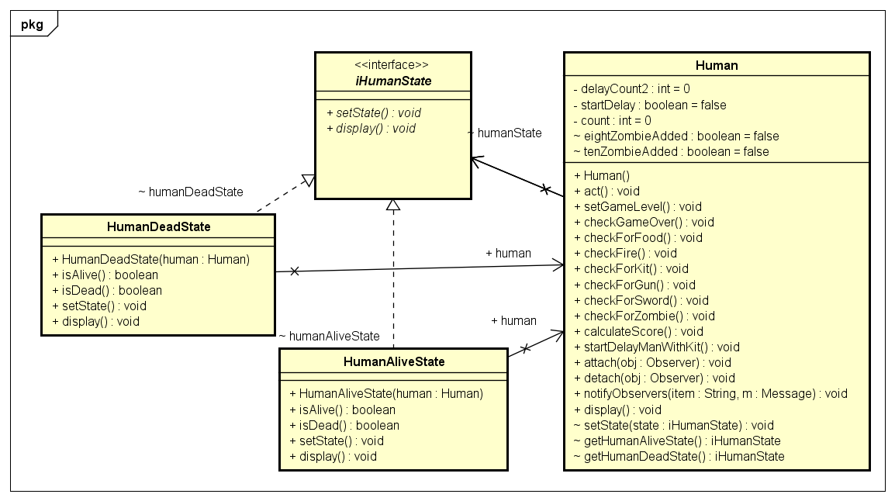
Human State Diagram

Slide 10
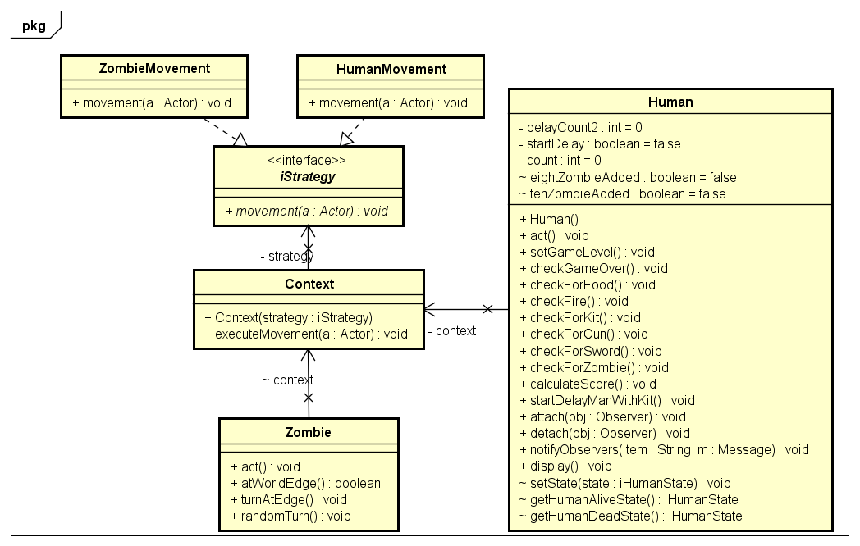
Movement Strategy pattern

Slide 11
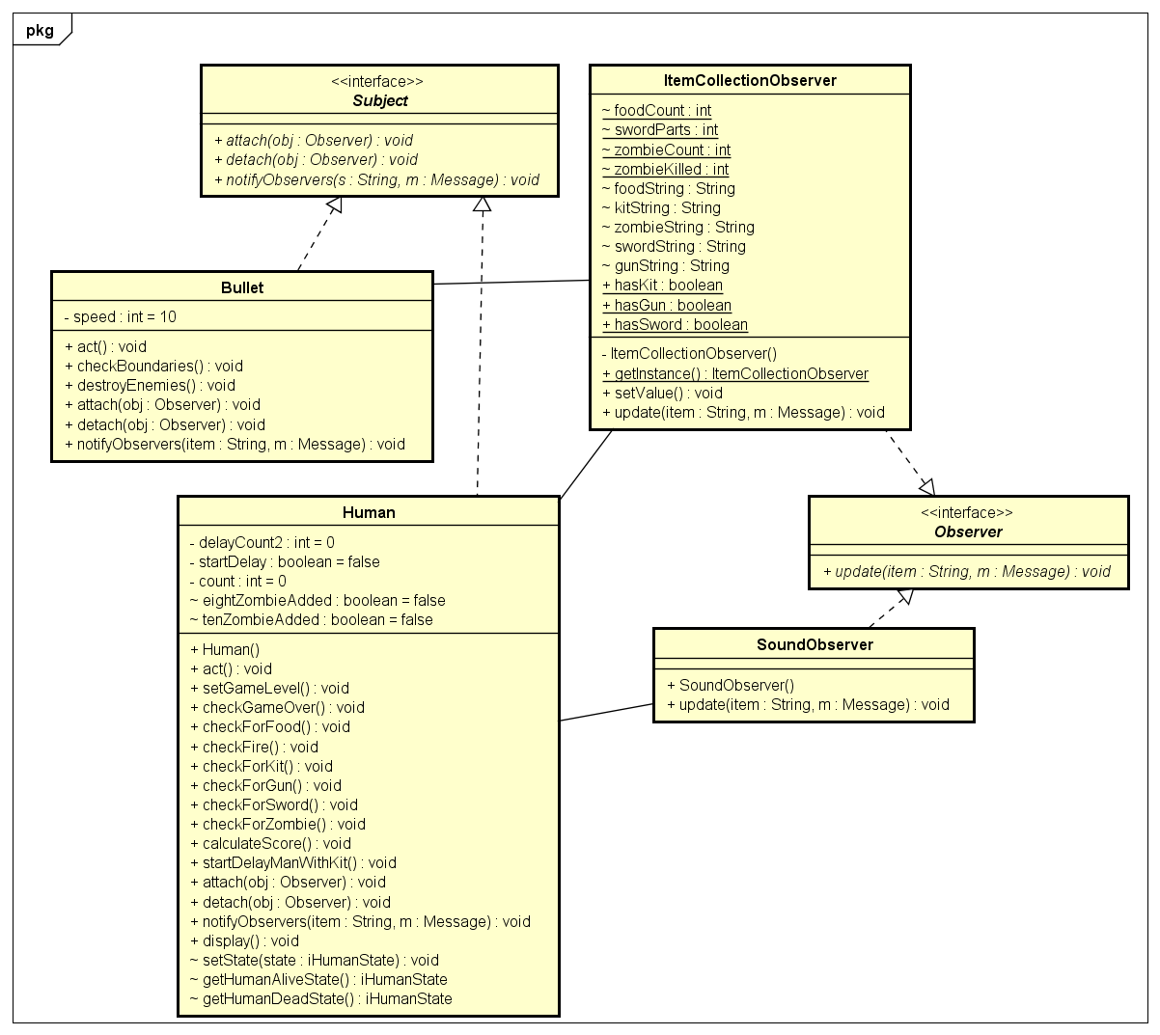
Observer Pattern Diagram

Slide 12
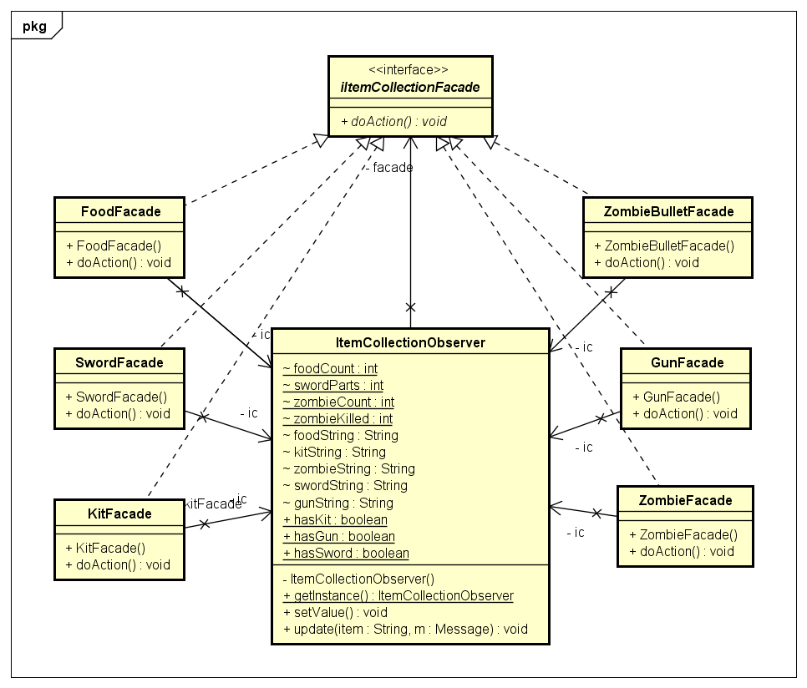
Facade pattern

Slide 13
Sword

Slide 14
XP Values : Communication
The primary value we focused on during our development was communication
We interacted regularly and had scrum meetings on scheduled time.
We made sure that everyone understands the current status of project and helped each to clear blockers.
During our meetings we took each others feedback positively and worked on them to keep the pace of development going

Slide 15
Questions??

Slide 16
Hope you enjoy the game!!!

